Slide 1

"KajBazar" – A Local Skill Marketplace App
A Trusted Friend Nearby

Slide 2
Presented To:
Presented By:
Jawad Hossain
Lecturer,
Department of CSE
University of Asia Pacific
Sumayea Akther Samia(22201075)
Tanzim Tabia(22201080)
Mahinur Akther(22201100)

Slide 3
About KajBazar
KajBazar is an innovative platform where individuals can learn daily, practical, and professional skills from expert trainers.
We focus on delivering real-world knowledge that leads to real earning opportunities.
After skill development, we connect learners with partner agencies and companies to begin their career journey.

Slide 4
The Problem
- Lack of a centralized platform for learners, trainers, and agencies to connect and collaborate locally.
Many skilled individuals remain underutilized due to poor online visibility or access to clients.
Freelancers and trainers often struggle to manage course delivery, payments, and ratings efficiently.
Agencies face difficulty in hiring verified talent quickly from a trusted local network.
Users have to rely on multiple platforms for courses, communication, and transactions, causing confusion and inefficiency.
.

Slide 5
Purpose
To create a unified platform where learners, trainers, and agencies can interact, share, and transact.
To help trainers and freelancers showcase their skills and manage bookings professionally.
To enable users to explore and enroll in verified skill-based courses offered locally or online.
To provide an efficient system for ratings, payments, and communication in one place.
To empower local talent and promote skill-sharing across communities.

Slide 6
Feature:
Home Page
Login/Signup System
User Profile Management
Courses Page
Trainer Directory
Agencies Section
Payment Gateway
Ratings & Reviews

Slide 7
Feature:
Contact Form
Dashboard
Search Functionality
Logout Feature

Slide 8
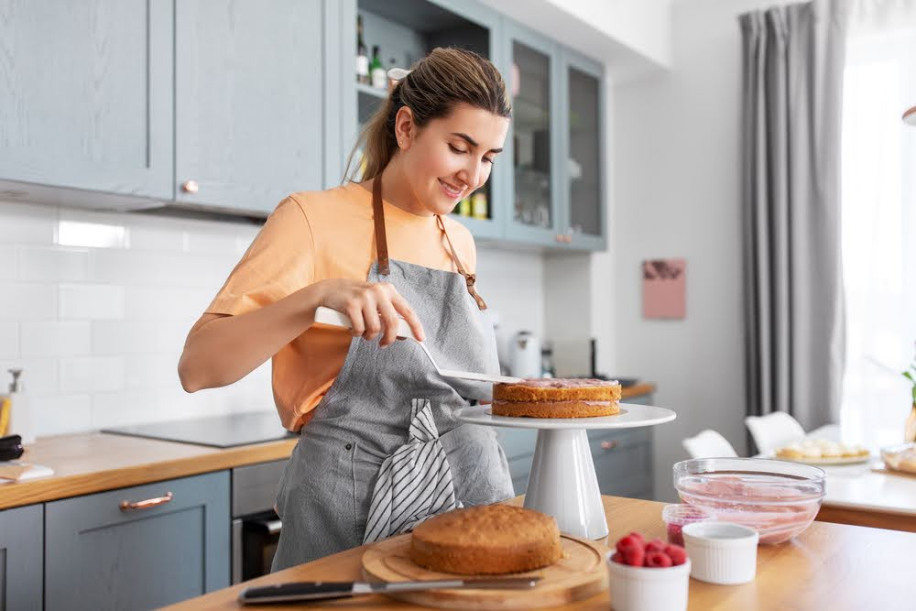

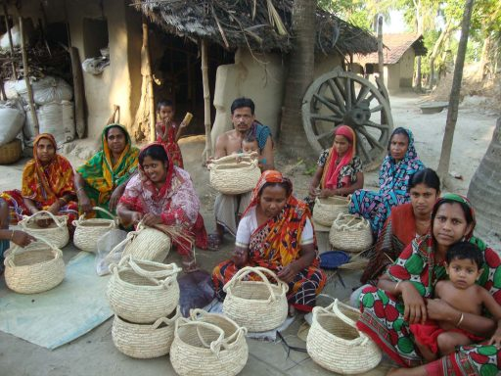
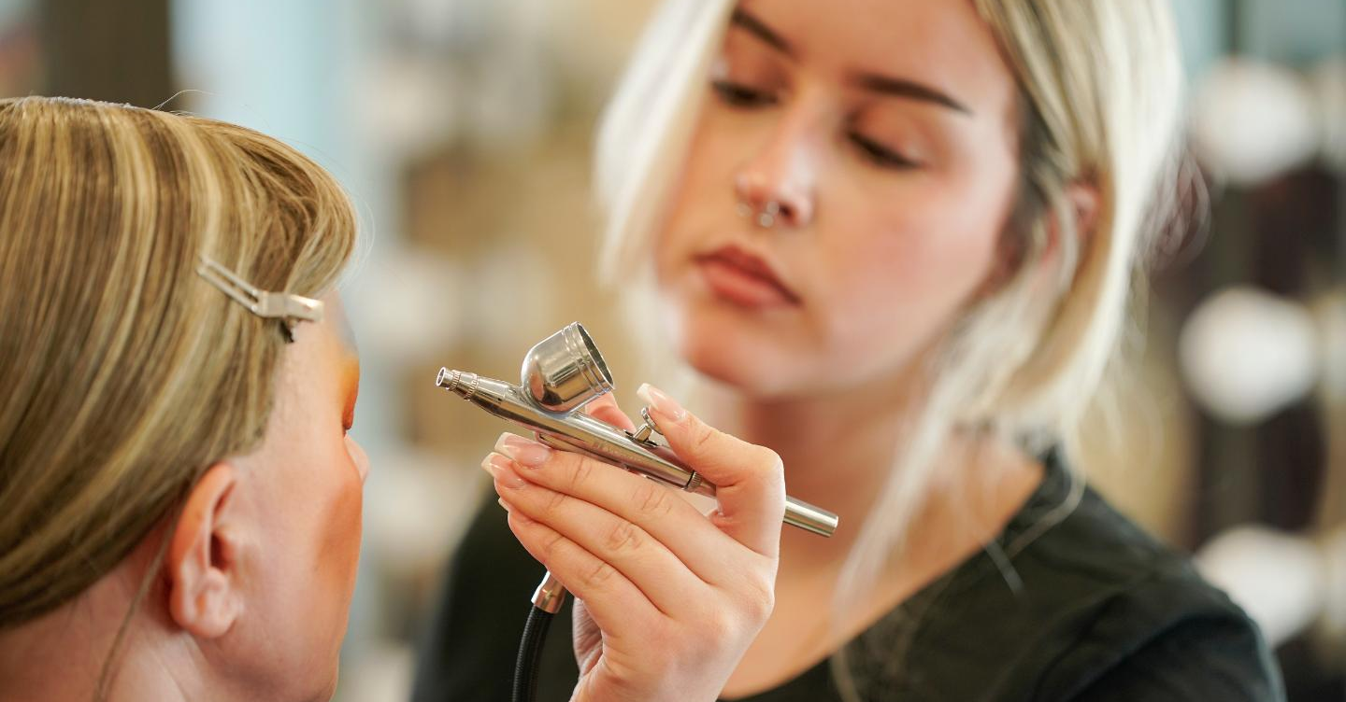
Culinary Expert
Driving Trainer
Handcraft
Makeup Artist

Slide 9


Slide 10
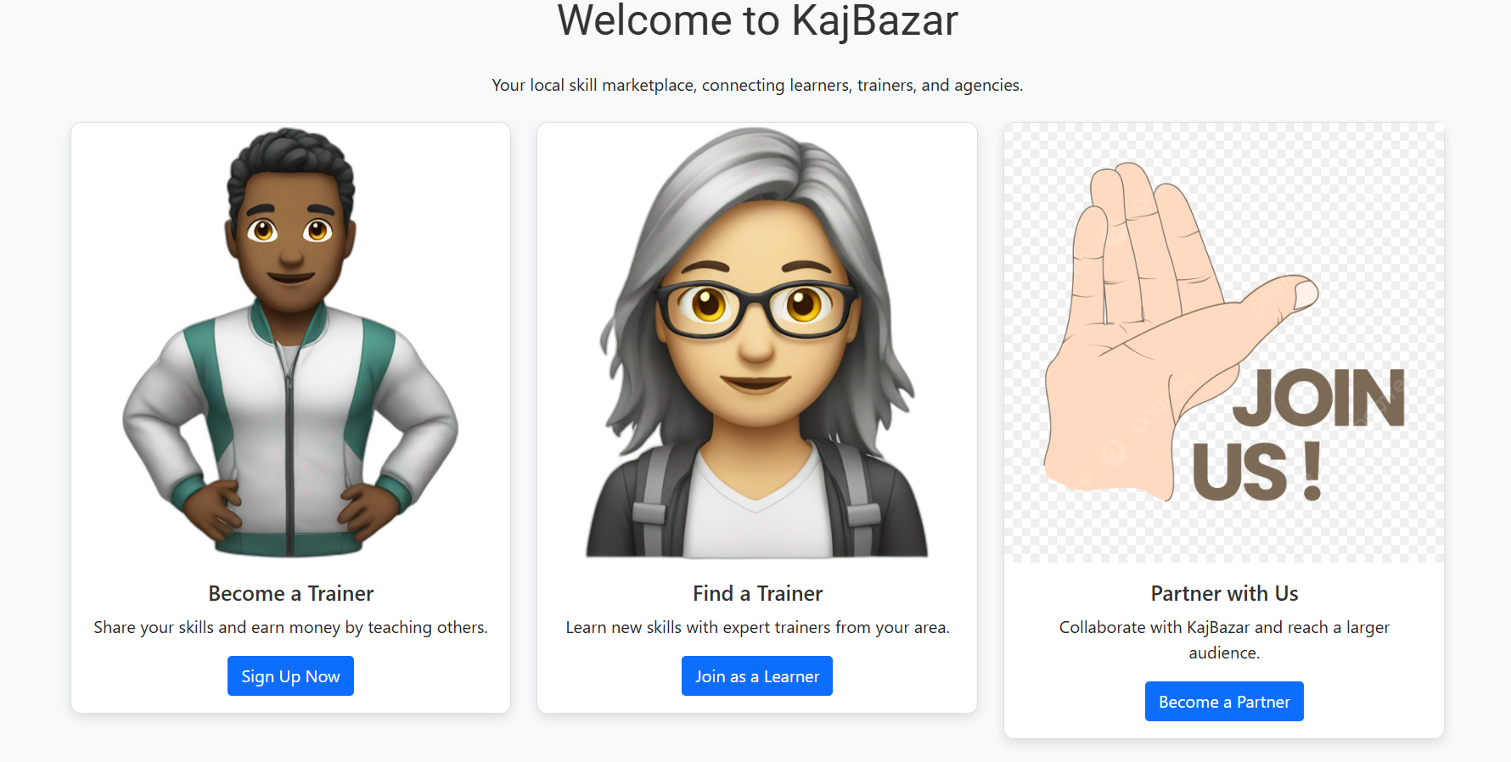

Slide 11
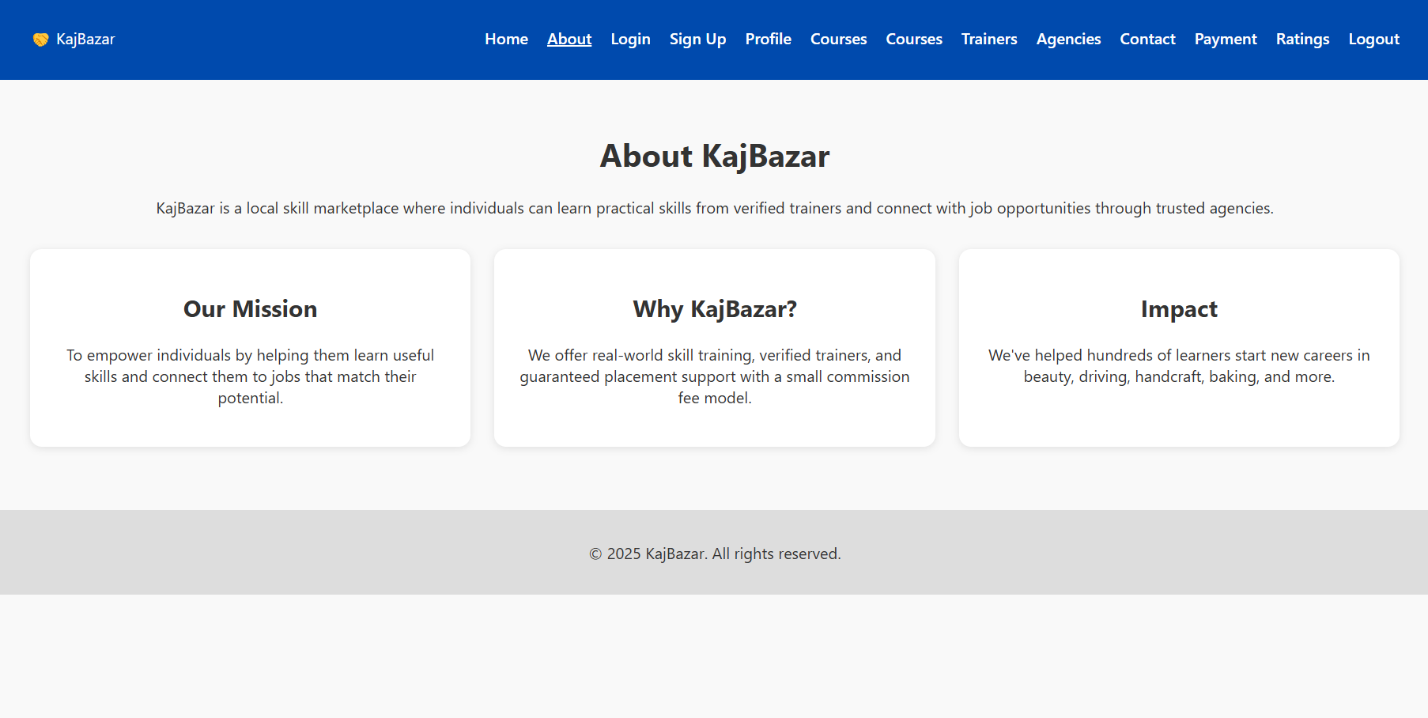

Slide 12
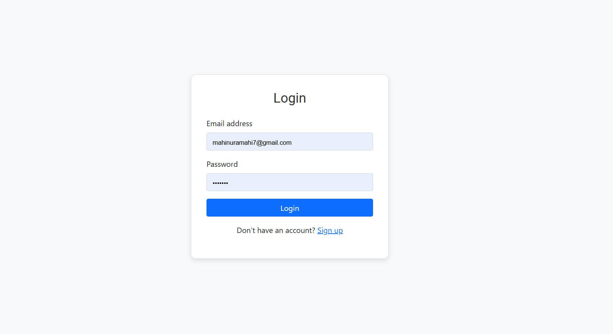

Slide 13
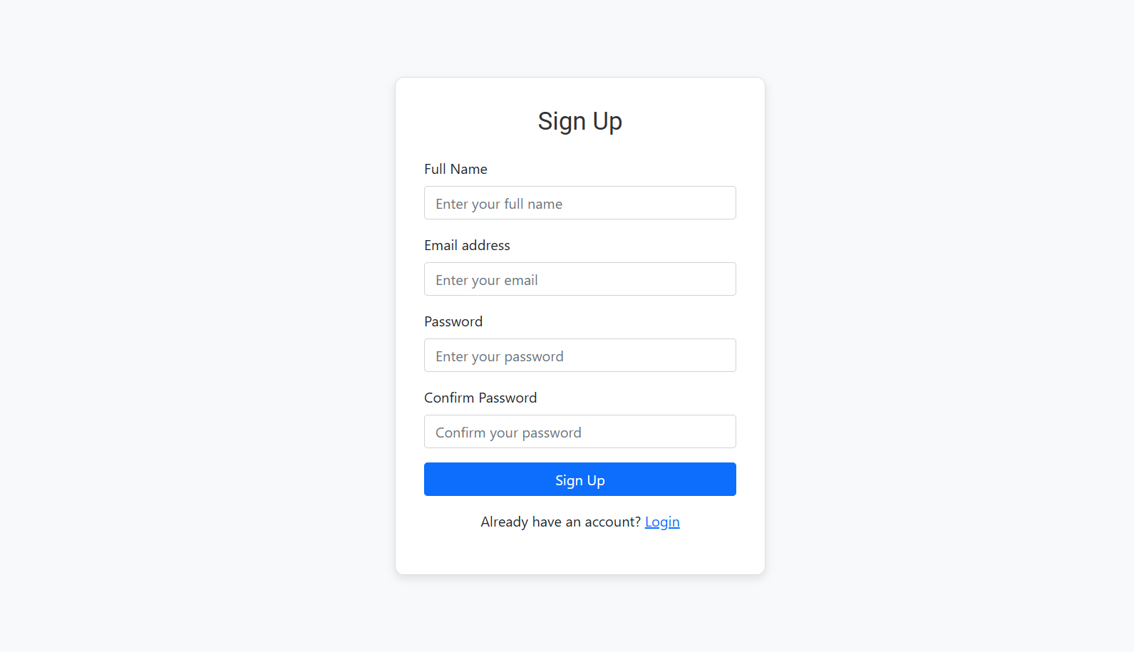

Slide 14
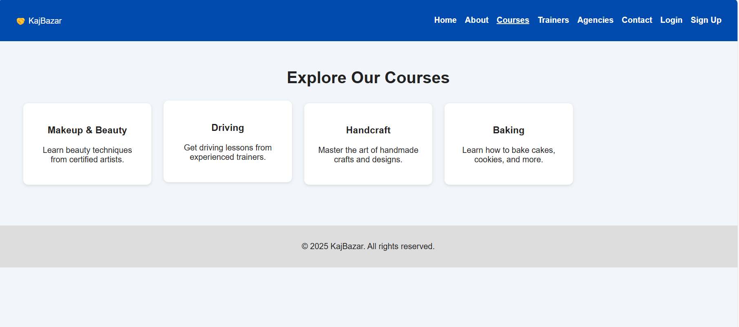

Slide 15
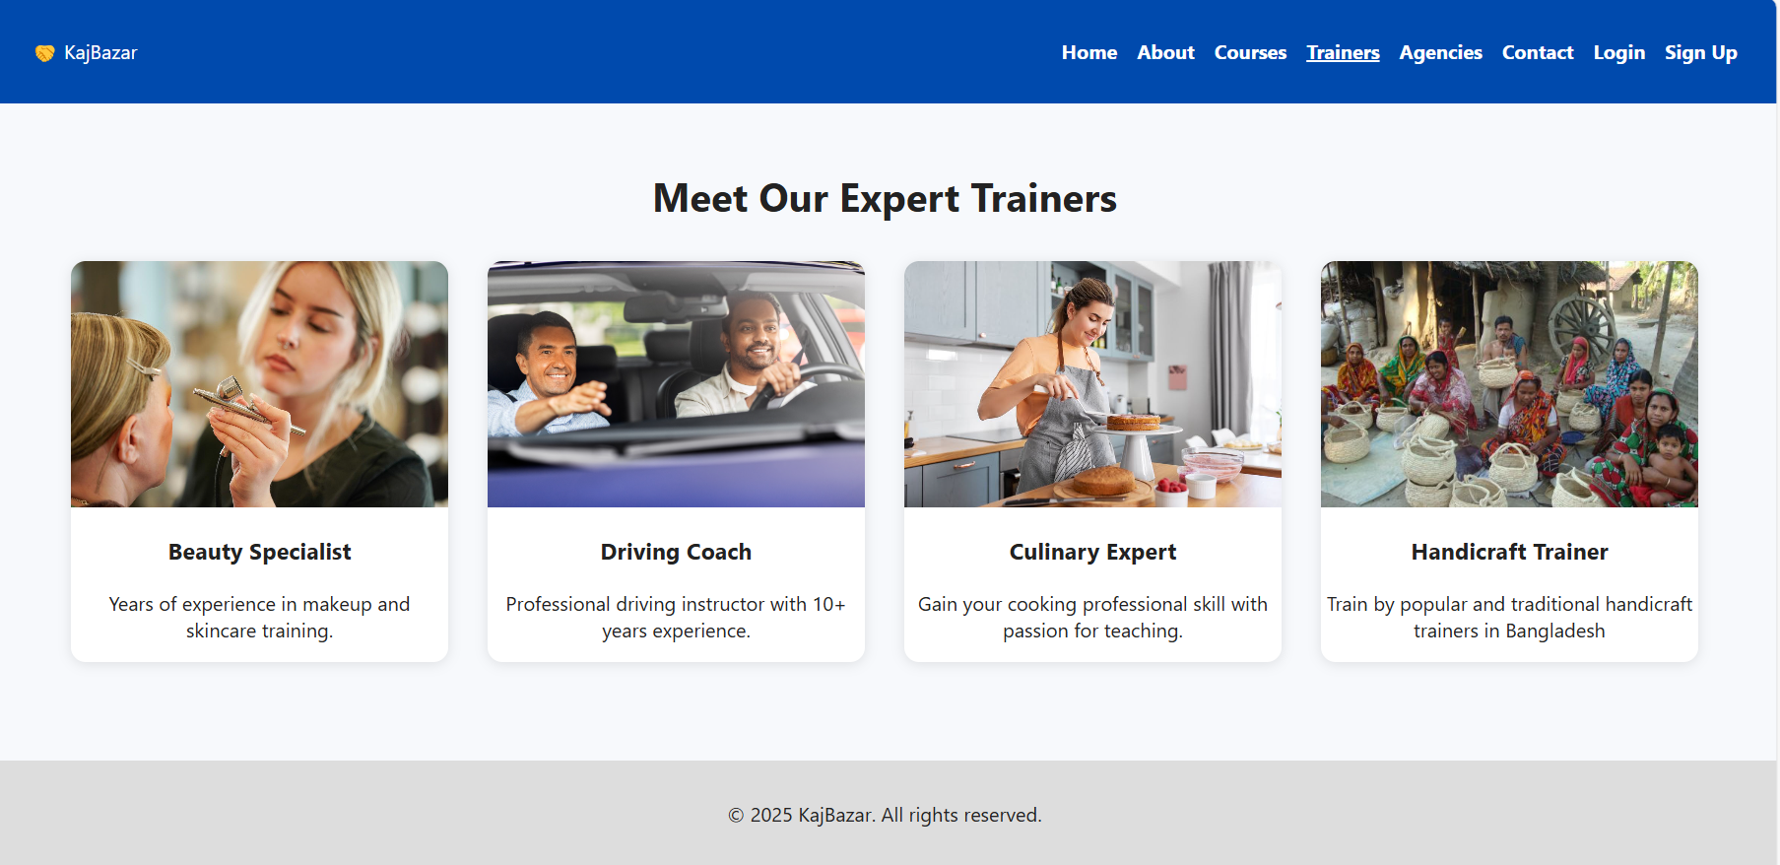

Slide 16
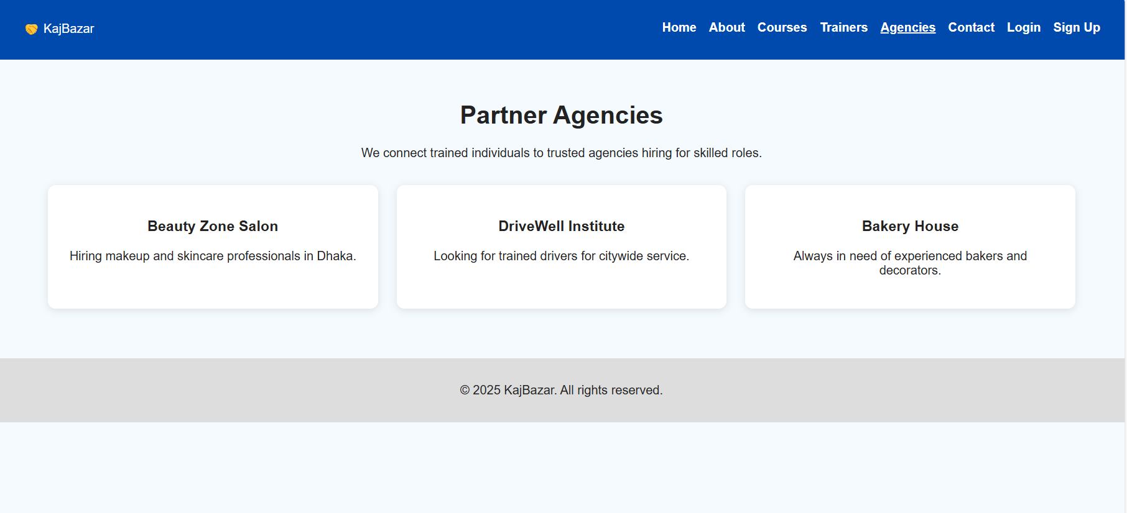

Slide 17
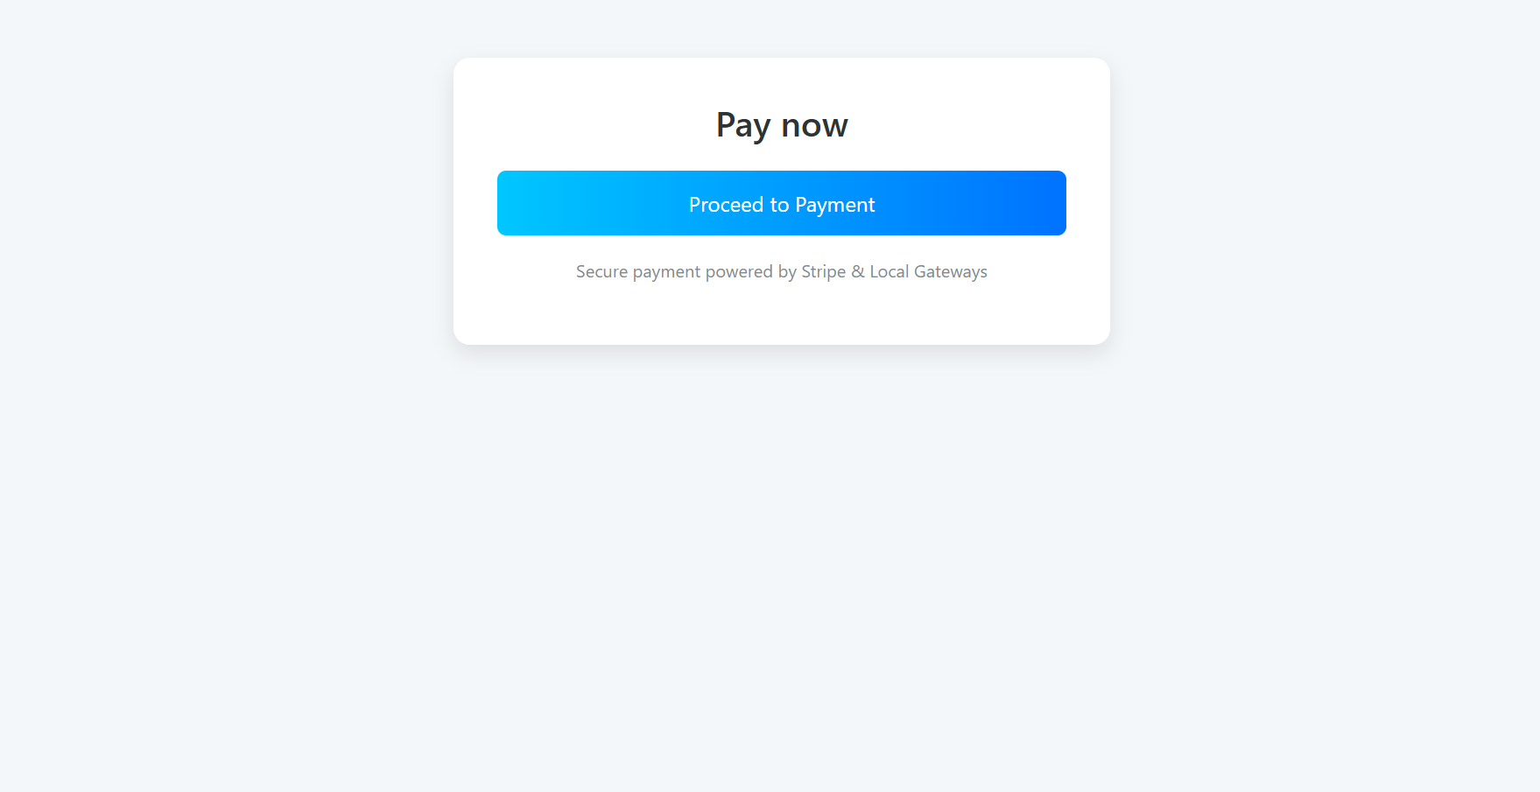

Slide 18
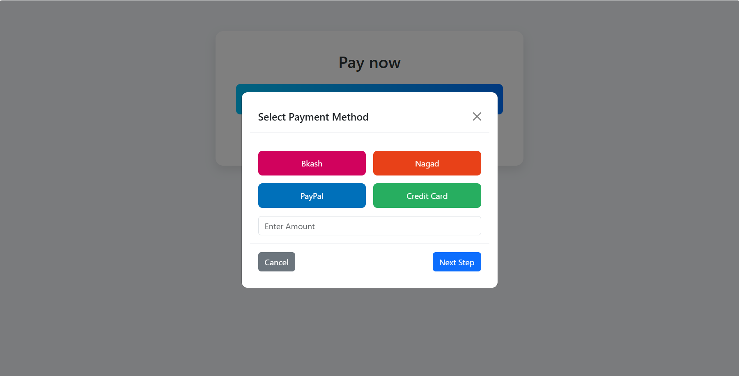

Slide 19
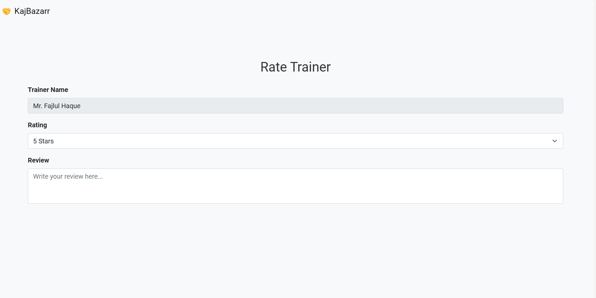

Slide 20
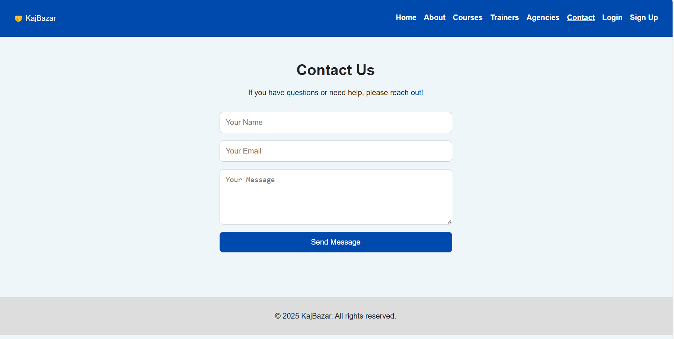

Slide 21
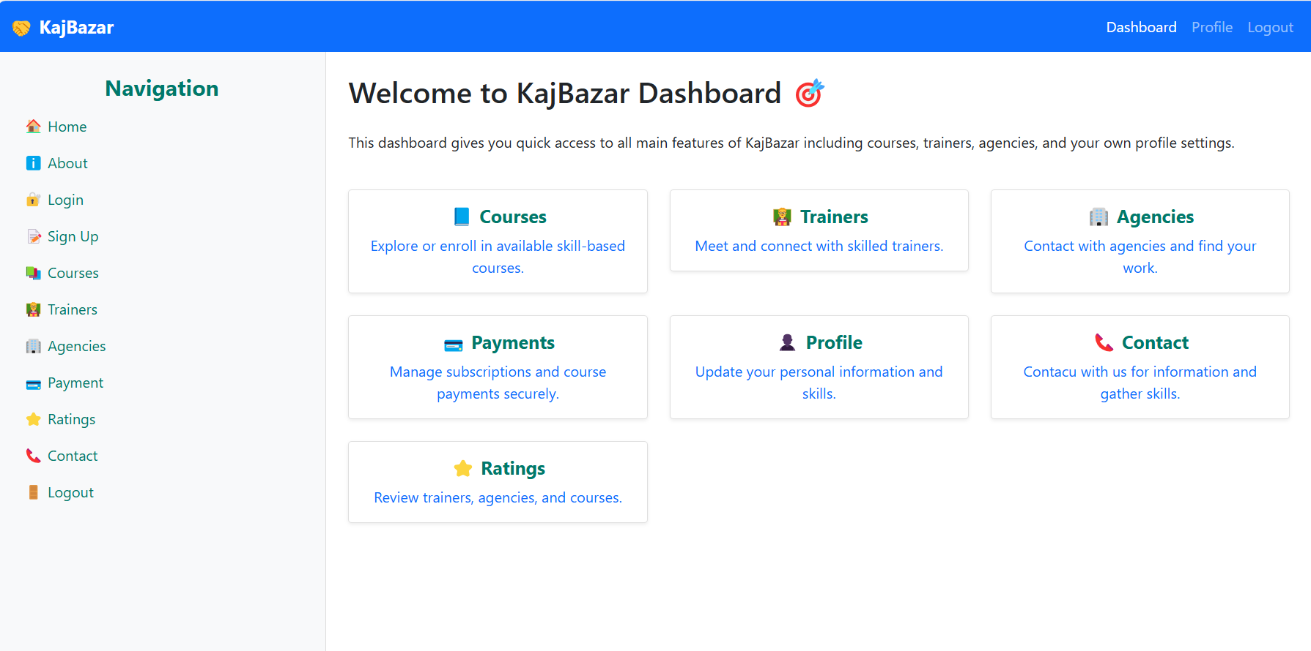

Slide 22
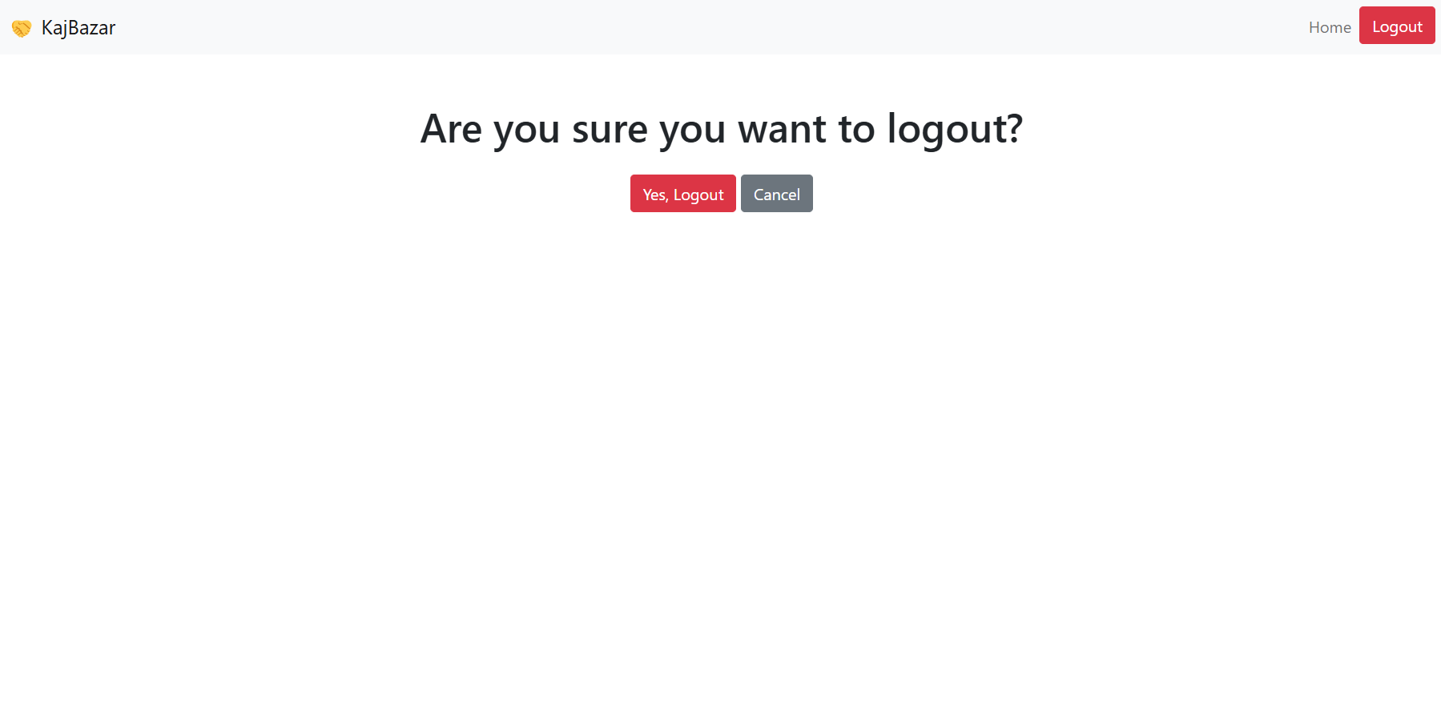

Slide 23
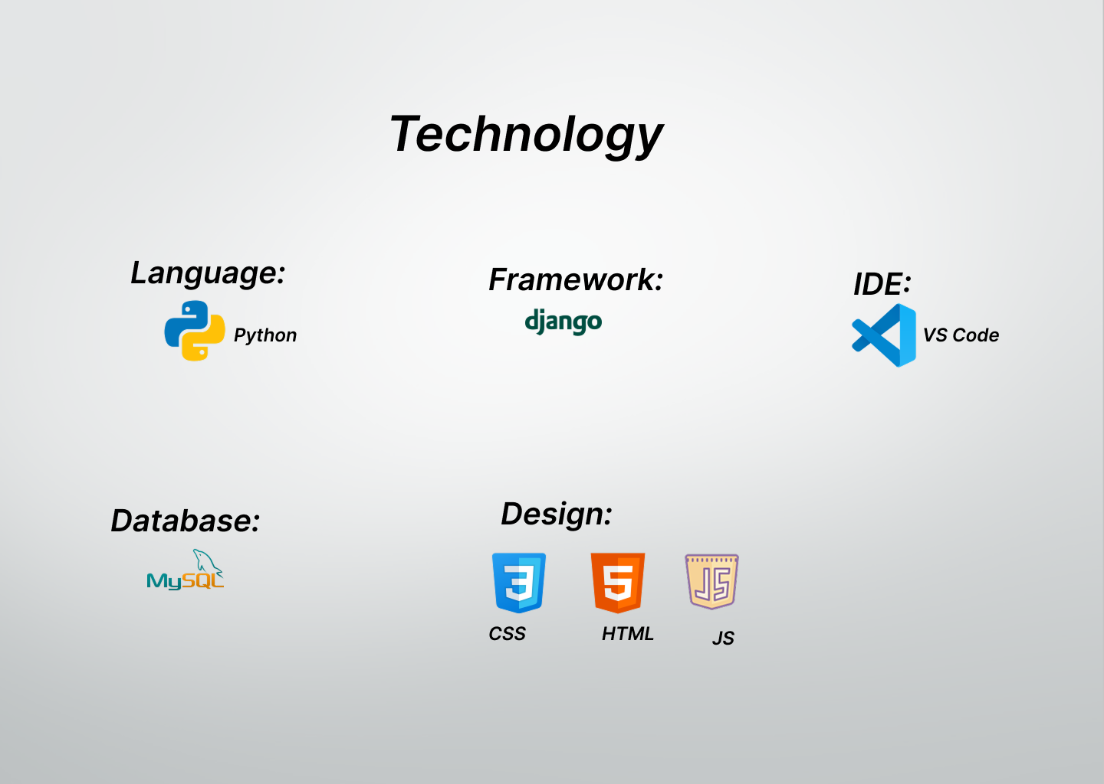

Slide 24
Thank You
Let's Grow Skills. Let's Grow Futures.

Slide 25
Any Question???

